Slide 1


Slide 2
Contact info
Professor Padraic Monaghan
Email: p.monaghan@lancaster.ac.uk
Office: Room C5, Fylde
Office hours: email to set up a time to meet

Slide 3
Module aims
Be able to utilise the popular and powerful R statistical application for your own research
Learn to identify the data analysis approach that can be applied to test theoretical beliefs against evidence
Recognise and apply appropriate statistical tests to different data
Describe the findings from analysing data effectively in text
Write a journal-style short report of a data analysis
Relate data analysis findings to scientific insights, linked to psychological theory

Slide 4
Assessment
Assessment will be 100% by coursework
A series of short assignments every two weeks (due Friday of weeks 2, 4, 6, 8, and 10, each contributing 10% of the grade)
The assignments are designed to make sure you develop the key skills of data preparation and analysis as the course progresses.
A short research report (1500 words, due after Christmas break, contributing 50% of the grade).
Analyse and report the findings from a previous experimental study in the format of the results section from an article in a leading short-format high impact journal (e.g., Psychological Science).
Concise, effective reporting of analytic methods, findings and interpretation according to the best professional standards.

Slide 5
Structure and set-up of the course
Ten weeks of material
Within each week there are three activities:
Recorded lectures
Background to the theory, discussion of the tests, introduction to the practical
Practical class
Materials to work through in conducting your own data analyses
Drop-in class
Follow-up opportunity to ask further questions about lecture and/or practical class material

Slide 6
Structure and set-up of the course: how it works
Here is how it works
Step 1. Watch the lecture(s)
Step 2. Get together in your practical group (you will be assigned to a group of 4 or 5 people) to go through the practical workbook.
Step 3. Assign a spokesperson from your group for that week. The spokesperson will collect the questions/queries about the workbook
Step 4. Attend the practical class as a group to go through the workbook (led by the spokesperson)
Tutors will be online to respond to the questions/queries
Step 5. Attend the drop-in session if you have further questions/queries
Step 6. In weeks 2, 4, 6, 8, 10 complete the assignment and submit by Friday 8pm

Slide 7
Objectives for Week 1
By the end of Week 1, you should be able to:
Understand the importance of data analysis and statistics
Identify types of data in psychology (nominal, ordinal, interval, ratio)
Understand means and standard deviations
Understand standardized scores (Z-scores)
Use R-studio to begin to manipulate data, investigate means and standard deviations, and convert scores into Z-scores

Slide 8
What is the point? I
The task: children read a list of words as quickly as possible, with rose-tinted glasses and with clear-lense glasses
Wow! A 50% increase! They really work!!
Or do they?
What more do you need to know about this study to be able to determine whether rose-tinted glasses help reading?
Clear-lense Glasses | Rose-tinted Glasses
50 words per minute | 75 words per minute
Ritchie, S. J., Della Sala, S., & McIntosh, R. D. (2011). Irlen colored overlays do not alleviate reading difficulties. Pediatrics, 128(4), e932-e938.
Available here: https://pdfs.semanticscholar.org/06ed/f49b323e86cc115ca05d882d44afef6b4848.pdf

Slide 9
What is the point? II
Clear-lense Glasses | Rose-tinted Glasses
50 words per minute | 75 words per minute
What more do you need to know about this study to be able to determine whether rose-tinted glasses help reading?
Was the test a good test (was it valid, was it reliable)?
How many children were tested? Were they tested in both conditions, or just one? If just one, how were they assigned to groups?
What is the variability of the mean?
Is 25 words per minute difference meaningful?
Is it a statistically significant difference?
Ritchie, S. J., Della Sala, S., & McIntosh, R. D. (2011). Irlen colored overlays do not alleviate reading difficulties. Pediatrics, 128(4), e932-e938.
Available here: https://pdfs.semanticscholar.org/06ed/f49b323e86cc115ca05d882d44afef6b4848.pdf

Slide 10
What is the point? III
Clear-lense Glasses | Rose-tinted Glasses
50 words per minute | 75 words per minute
The 50 versus 75 words per minute difference in Ritchie et al. (2011) came from a group of only 3 of the children.
They tested a further 57 children, and found absolutely no difference.
This raises another question about how we can test whether there is no difference. But that’s for another day…
What we can conclude from Ritchie et al.’s study is “there is no evidence for a difference”.
Ritchie, S. J., Della Sala, S., & McIntosh, R. D. (2011). Irlen colored overlays do not alleviate reading difficulties. Pediatrics, 128(4), e932-e938.
Available here: https://pdfs.semanticscholar.org/06ed/f49b323e86cc115ca05d882d44afef6b4848.pdf

Slide 11
The point: critical about claims
We should be critical over claims about what results show
We can be informed about study designs
We can interpret the meaning of data, analyse it, and determine when it relates to theories, and when it supports conclusions
“88.2% of statistics are made up on the spot” (Vic Reeves)
But: you can’t make statistics mean anything
And: we are not fed up of so-called experts
BBC article on Michael Gove comments on fed up of experts
Krause, N. M., Brossard, D., Scheufele, D. A., Xenos, M. A., & Franke, K. (2019). Trends—Americans’ trust in science and scientists. Public Opinion Quarterly, 83(4), 817-836.

Slide 12
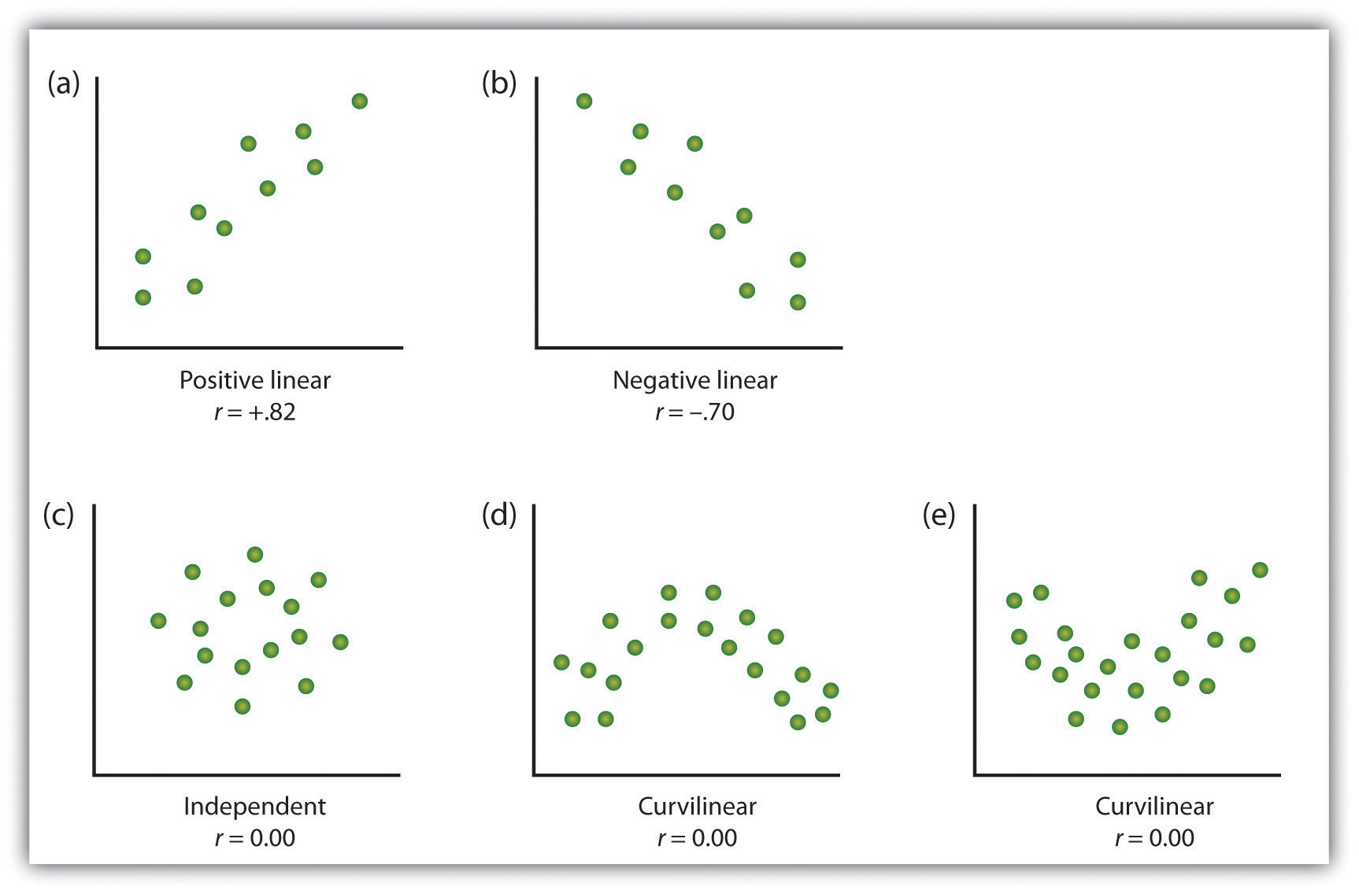
The point: patterns of data
Examining patterns in data (critically)
Finding the right way to describe and test these patterns
https://opentextbc.ca/introductiontopsychology/chapter/2-2-psychologists-use-descriptive-correlational-and-experimental-research-designs-to-understand-behavior/
Notes:
Here is an example. On the x axis is the ratings of emotionality of tv adverts, and on the y axis is the sales success of the product. What relationship does each graph show?

Slide 13
Summary
What’s the point of statistics?
Understand and be critical of claims relating to data
Link data to theories

Slide 14
Module outline week1-5
Week 1: Introducing data, introducing Rstudio
Week 2: Manipulating data, using Rstudio
Week 3: Exploring data and creating figures and graphs, using Rstudio
Week 4: Categorical data and the chi-squared test – testing random versus structured?
Week 5: t-tests – testing whether two groups are different

Slide 15
Module outline week6-10
Week 6: Open data and your research report
Week 7: Questions, measurements and people
Weeks 8: Estimating and testing associations: correlations
Weeks 9: Predicting behaviour: the linear model
Weeks 10: Predicting behaviour: the linear model part 2

